Slide 1

Ruby Language

Slide 2
About today…
Loops
Types of Loops
While
Until
For
Each

Slide 3
Ruby Loops
Definition
Loops allow us to execute a block of code repeatedly based on a condition
Purpose
Essential for automating repetitive tasks in programming
Ruby's Approach
Ruby offers various loop constructs to suit different looping scenarios efficiently

Slide 4

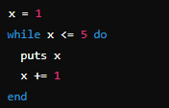
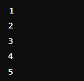
While Loop
Definition
The while loop executes the code block as long as the condition remains true
Syntax
Output
Example

Slide 5

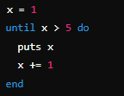
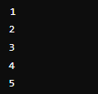
Until Loop
Definition
The until loop executes the code block until the condition becomes true
Syntax
Output
Example

Slide 6


For Loop
Definition
The for loop iterates through a range or a collection
Syntax
Output
Example

Slide 7



Each Loop
Definition
The each loop is used specifically for iterating through arrays or collections
Syntax
Output
Example

Slide 8


Slide 9

What is the purpose of the while loop in Ruby?
How does the until loop differ from the while loop in Ruby?
Which loop is best suited for iterating through a range of values in Ruby?

Slide 10

Task 1
Write a Ruby program that uses a while loop to print numbers from 1 to 5
Task 2
Create a Ruby program that utilizes an until loop to count from 1 to 5
Task 3
Develop a Ruby script using a for loop to iterate through numbers from 1 to 5 and print each number
Task 4
Write a Ruby program that uses an each loop to iterate through an array of fruits (['apple', 'banana', 'cherry']) and prints each fruit

